Slide 1
DS LAB 2

Slide 2
Omar el dawy Ibrahim el dawy 21010864
Bahaa Khaled mohammed 21010383
Ali Mahmoud sobhi 21010842
Abdullah mohammed ali zein el-abdeen 21011644
Pola hany Fayez 21010387

Slide 3
UNIVERSAL HASHING
Definition :
The Universal Method of hashing aims to minimize the number of collisions in a hash table by using a hash function that is nearly "universal". A hash function ℎ is said to be universal if, for any two distinct keys 𝑘1​ and 𝑘2​, the probability that ℎ(𝑘1) equals ℎ(𝑘2) is at most 1/𝑚​, where 𝑚 is the number of buckets in the hash table.
The idea is to randomly select the hash function ℎ from a family of hash functions that satisfies this property. This randomness helps distribute the keys uniformly across the hash table, reducing the likelihood of collisions.

Slide 4
Analysis :
Collision Probability: The main advantage of the Universal Method is its ability to maintain a low collision probability, which is crucial for the performance of hash tables. By ensuring that the probability of a collision is at most 1/𝑚, where 𝑚 is the number of buckets, we can achieve a more balanced distribution of keys.
Flexibility: The Universal Method allows for a wide variety of hash functions to be used, as long as they belong to the universal family. This flexibility can be beneficial in different scenarios where specific properties or performance characteristics are desired.
Performance: While the Universal Method aims to minimize collisions, the actual performance can still vary based on the chosen hash function and the distribution of keys. In practice, it often performs well but may require testing and tuning to optimize for specific applications.
Implementation: Implementing the Universal Method typically involves choosing a random hash function from a universal family. This can be done by using a randomized algorithm or by pre-computing a set of hash functions and selecting one at random.

Slide 5
O(N^2)
Definition :
The O(N^2) - Space Solution is a computational technique that involves the use of a table of quadratic size in relation to the size (N) of a dictionary (S).
Approach :
Let H be universal and M = N^2 Pick a random h from H and try it out, hashing everything in S. So, we just try it, and if we got any collisions, we just try a new h. On average, we will only need to do this twice.

Slide 6
Analysis :
The O(N^2) - Space Solution technique is particularly noteworthy for its efficient handling of collisions in hashing. However, it is crucial to understand that while this method may excel in terms of collision management, it can be quite inefficient in terms of space utilization.
As the size of the input (N) increases, the space required (N^2) escalates at a much faster rate. This rapid growth can quickly consume available memory resources, especially when dealing with large inputs.
This technique is typically employed when the priority is to reduce collisions over the conservation of space. However, in many practical scenarios, a balance between space and time complexity is sought. Therefore, alternative techniques might be preferred if space conservation is a concern.

Slide 7
O(N)
Definition :
The O(N) - Space Solution refers to a technique where a table of linear size in the size N of a dictionary S is used. This is a complexity notation that indicates that the space (memory) required by the algorithm grows linearly with the size of the input data (N).
Approach :
The main idea for this method is to use universal hash functions in a 2-level scheme. The method is as follows. We will first hash into a table of size N using universal hashing. This will produce some collisions. However, we will then rehash each bin using Method 1, squaring the size of the bin to get zero collisions.

Slide 8
Analysis :
This technique is interesting due to its method of using universal hash functions in a 2-level scheme to avoid collisions in hashing. This approach is more space-efficient than the O(N^2) - Space Solution as it only requires linear space. However, it may not handle collisions as efficiently as the O(N^2) - Space Solution.
The choice between the O(N) - Space Solution and the O(N^2) - Space Solution (or any other technique) depends on the specific requirements and constraints of the problem at hand. It’s always a good idea to analyze the trade-offs before deciding on a particular approach.

Slide 9
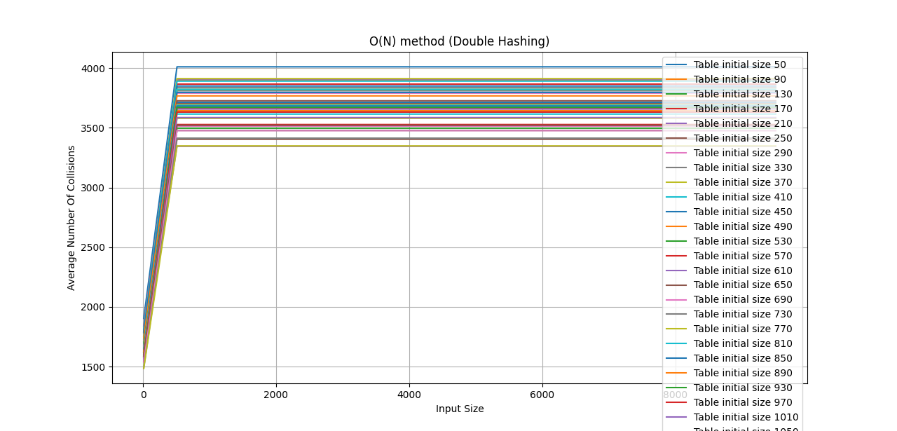
Average collisions comparisons

Slide 10
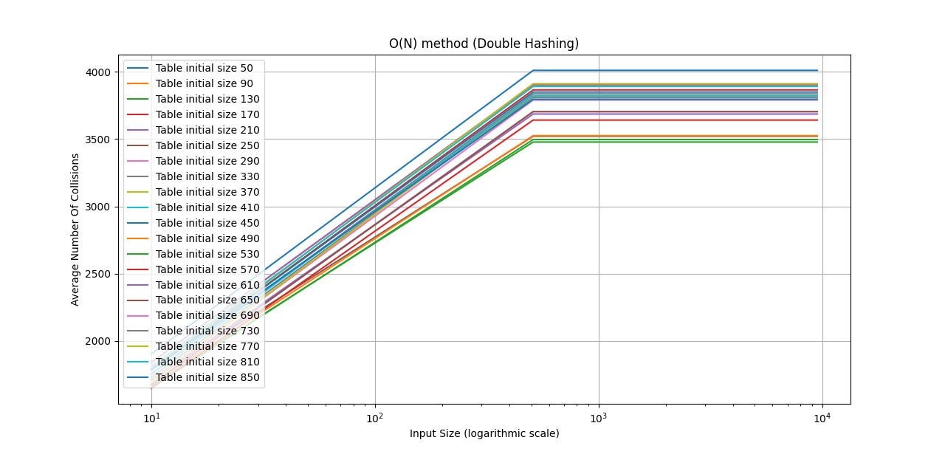
Average collisions comparisons

Slide 11
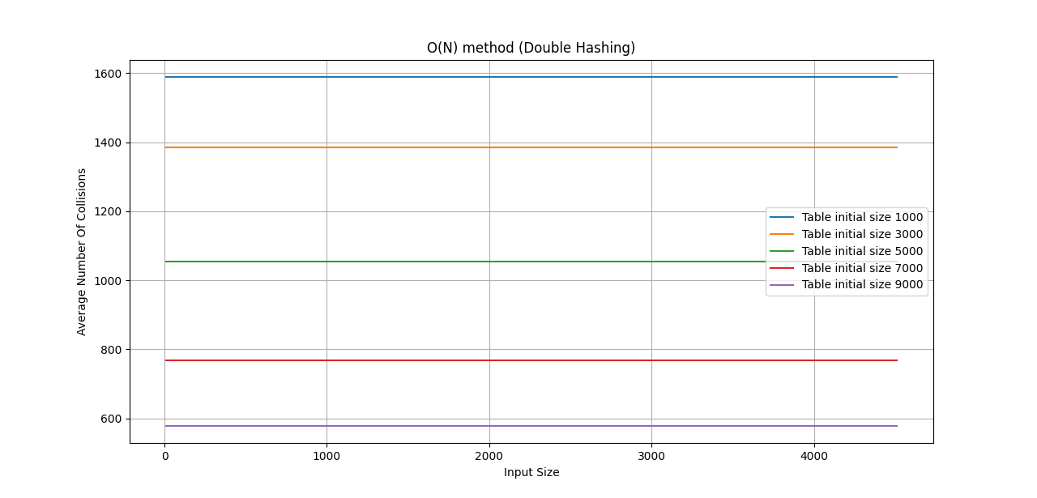
Average collisions comparisons

Slide 12
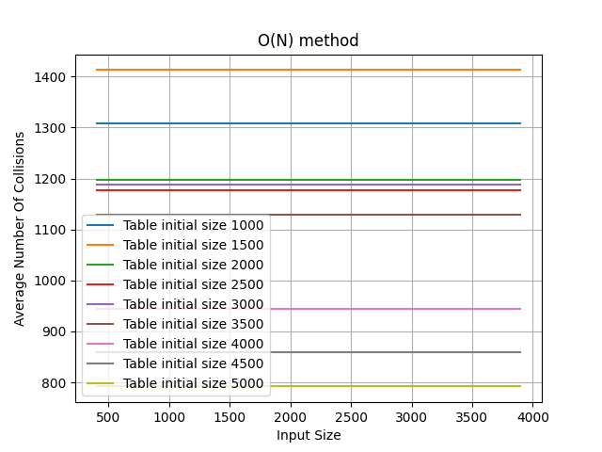
Average collisions comparisons

Slide 13
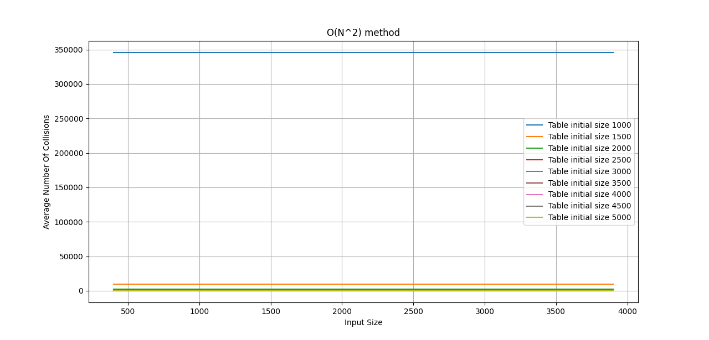
Average collisions comparisons

Slide 14
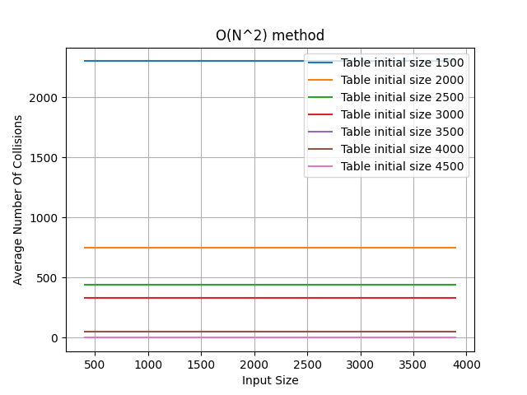
Average collisions comparisons

Slide 15
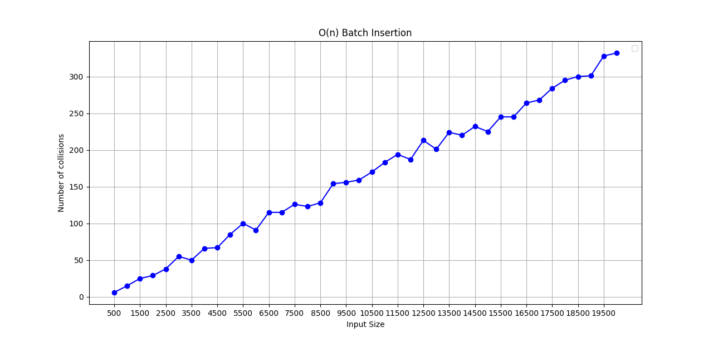
Number of batch Collision O(N)

Slide 16
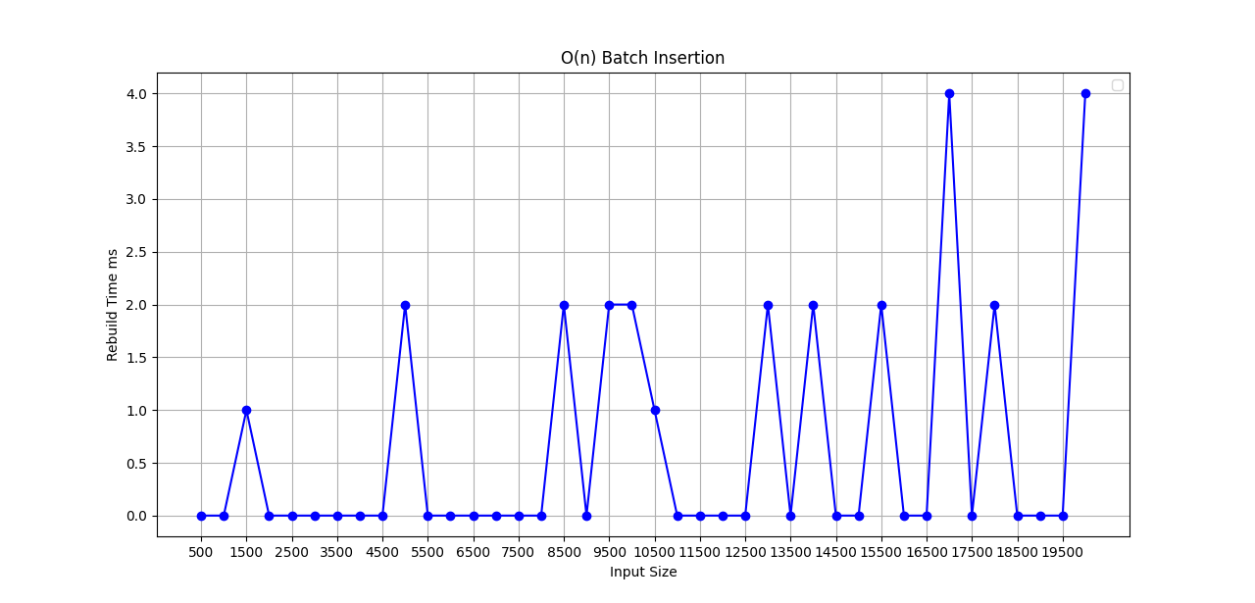
Number of batch rebuild O(N)

Slide 17
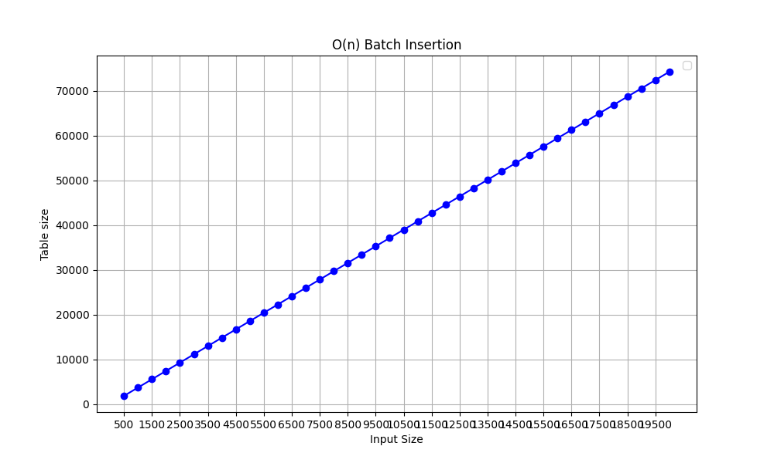
Table batch space O(N)

Slide 18
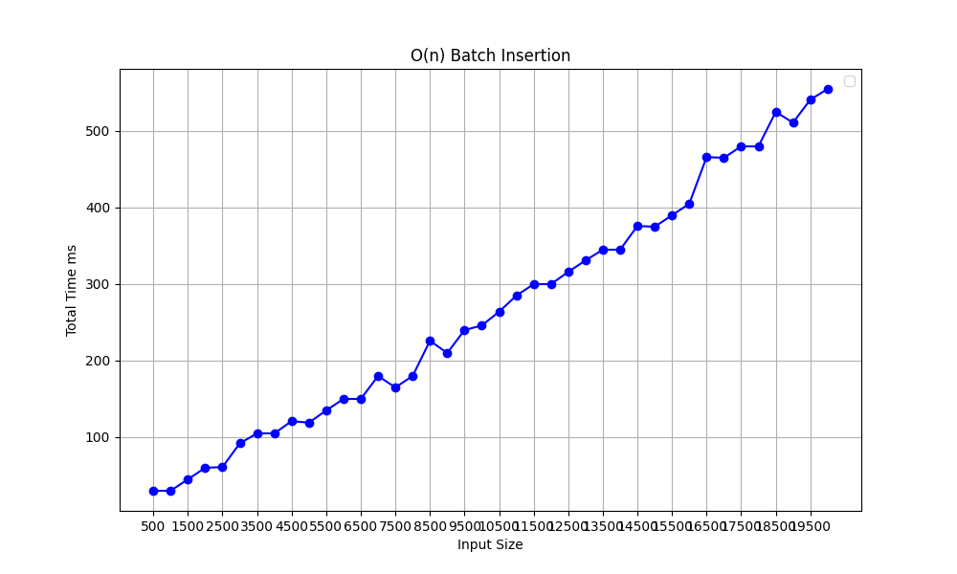
Batch Time O(N)

Slide 19
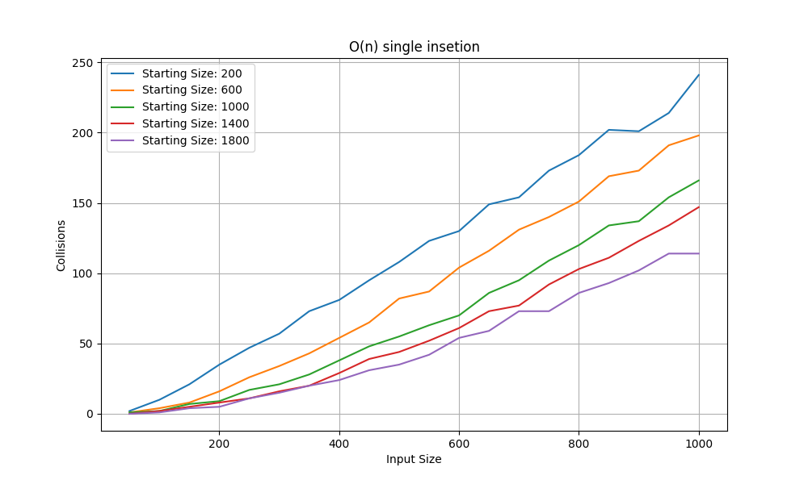
Number of single collision O(N)

Slide 20
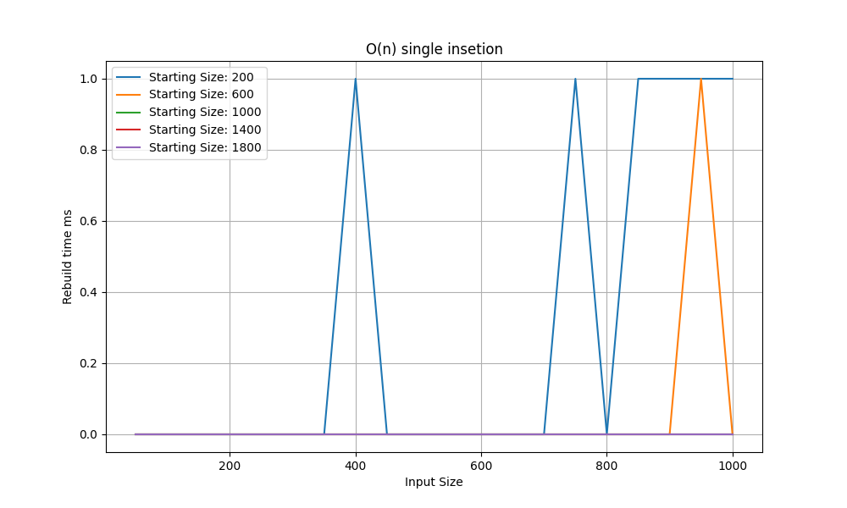
Number of single rebuild O(N)

Slide 21
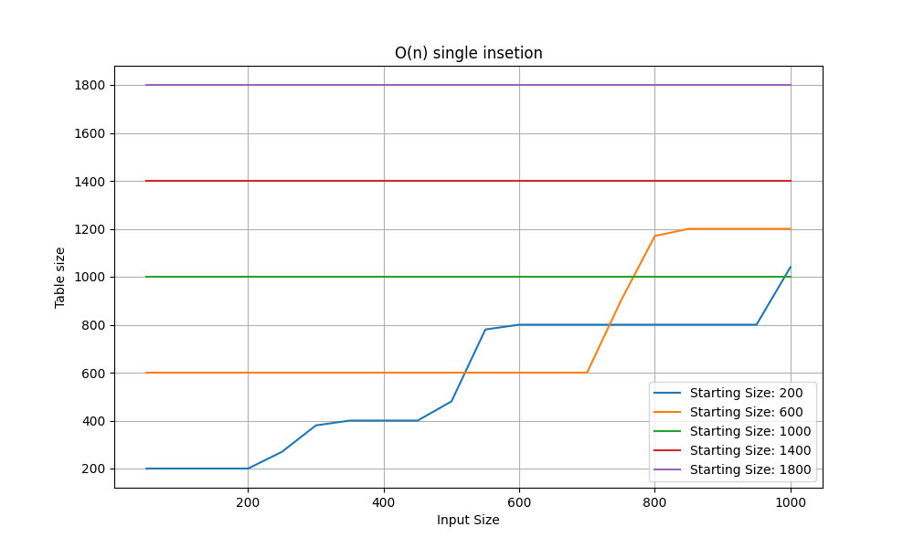
Single insert table size O(N)

Slide 22
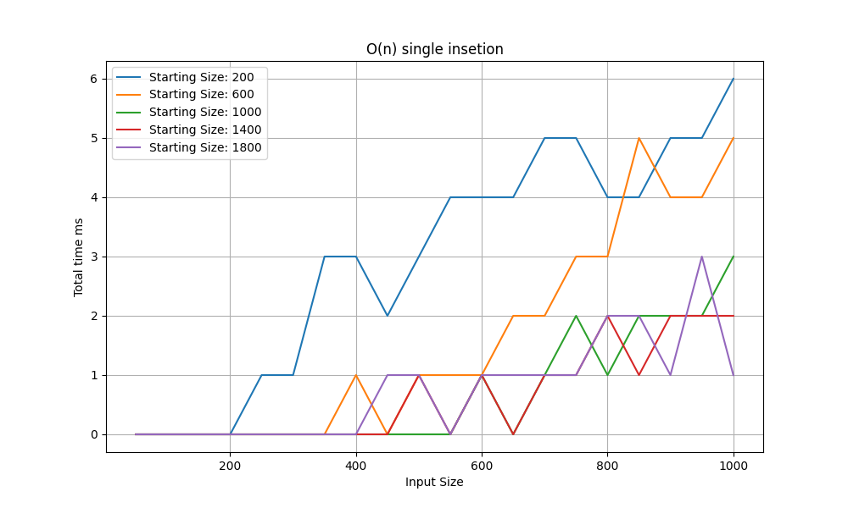
Single time O(N)

Slide 23
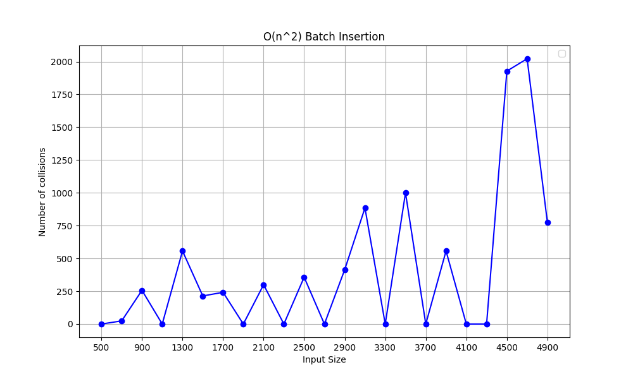
Number of batch collision O(N^2)

Slide 24
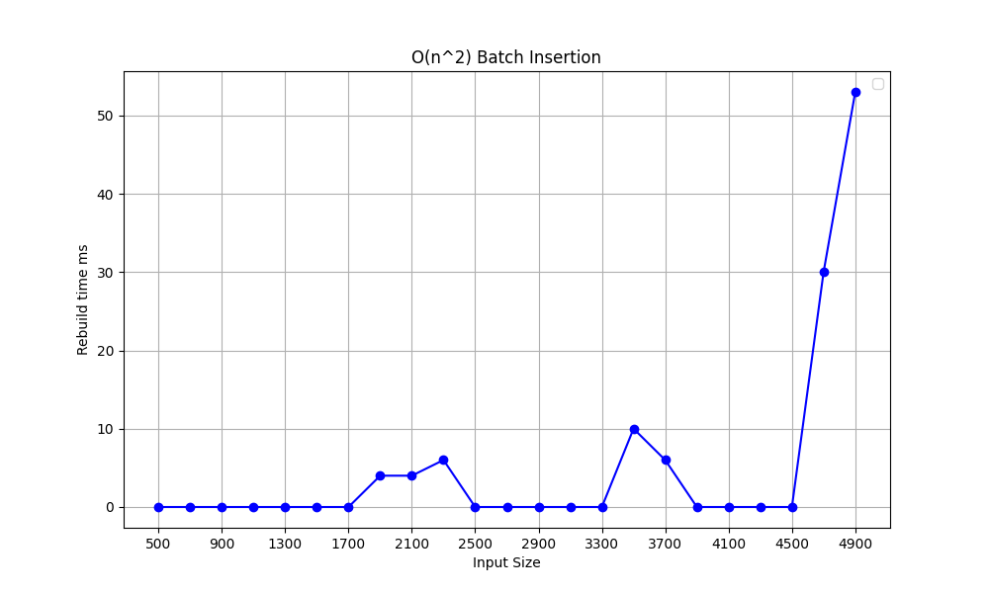
Number of batch rebuild O(N^2)

Slide 25
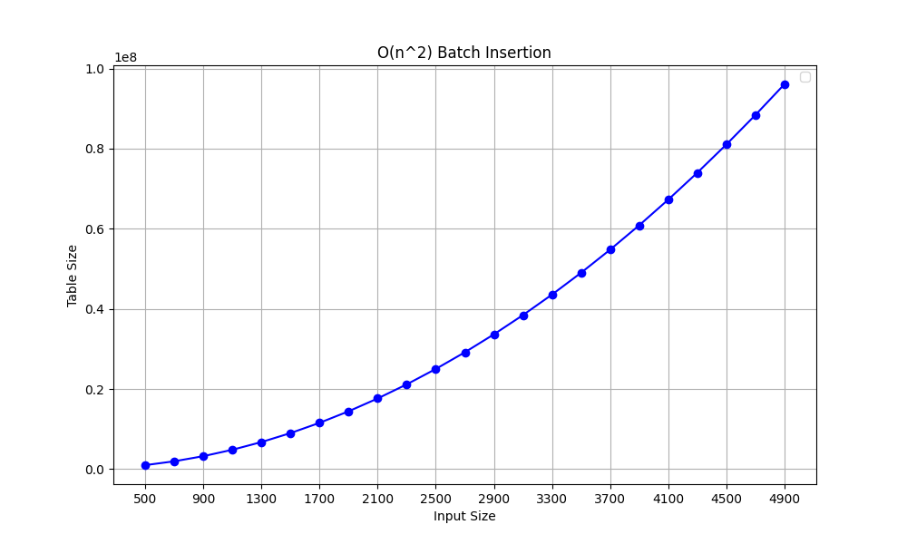
Table batch space O(N^2)

Slide 26
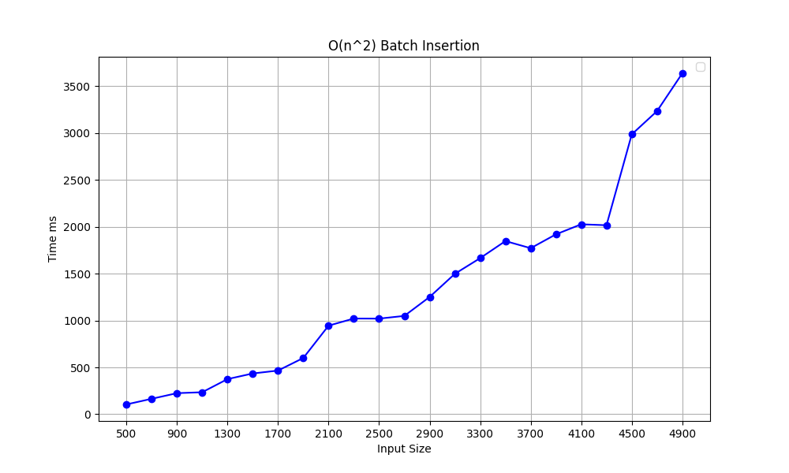
Batch time O(N^2)

Slide 27
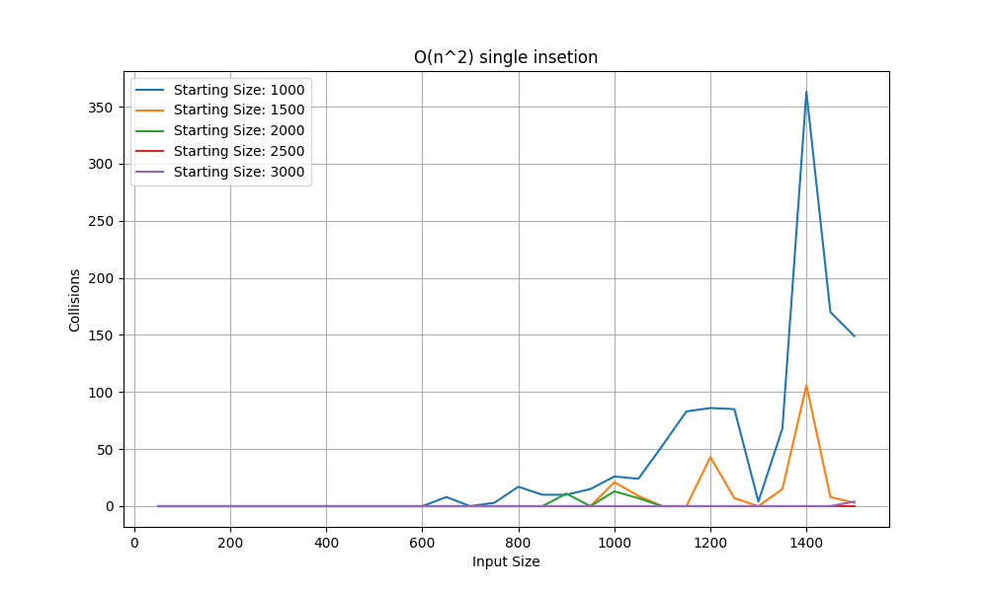
Number of single collision O(N^2)

Slide 28
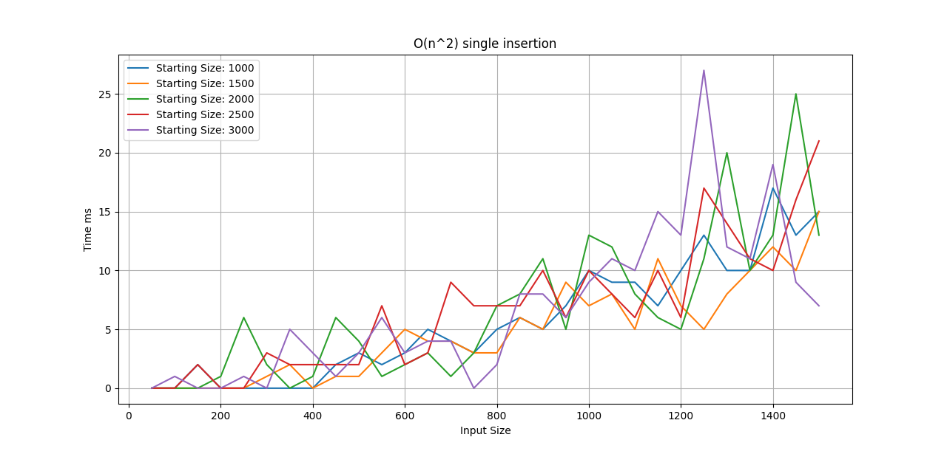
Single time O(N^2)

Slide 29
Thank you

